Slide 1

Minor Project
COVID-19: Face Mask Detector
PRESENTED BY:
SUBHASISH NAYAK
(B.TECH 3RD YEAR)(EEE)
ROLL_NO: 521246

Slide 2
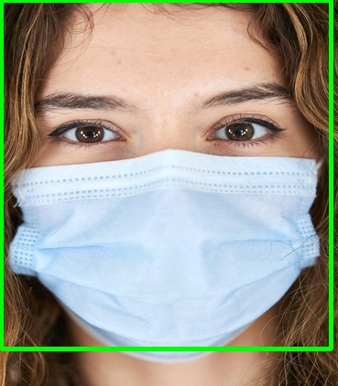
INTRODUCTION
In this project we have used OpenCV, Keras/TensorFlow, and Deep Learning.We introduce a mask face detection model that is based on computer vision and deep learning. The proposed model can be integrated with cameras to i surveillance mpede the COVID-19 transmission by allowing the detection of people who are wearing masks not wearing face masks. The model is integration between deep learning and classical machine learning techniques with opencv, tensor flow and keras.

Slide 3
OBJECTIVES
In this PROJECT we created a COVID-19 face mask detector using OpenCV, Keras/TensorFlow, and Deep Learning.
To create our face mask detector, we trained a two-class model of people wearing masks and people not wearing masks.
We fine-tuned MobileNetV2 on our mask/no mask dataset and obtained a classifier that is ~99% accurate.
We then took this face mask classifier and applied it to images by: Detecting faces in images.
Extracting each individual face
Applying our face mask classifier
Our face mask detector is accurate, and since we used the MobileNetV2 architecture, it’s also computationally efficient.

Slide 4
TOOLS AND TECHNOLOGY USED
Python:Python is an interpreted, high-level and general-purpose programming language.
Jupyter notebook: The Jupyter Notebook is an open-source web application that allows you to create and share documents that
contain live code, equations, visualizations and narrative text.
Keras: Keras is an open-source library that provides a Python interface for artificial neural networks.
Tensorflow: TensorFlow is a free and open-source software library for machine learning.
Convolutional neural network:In neural networks, Convolutional neural network(CNNs) is one of the main categories to do images recognition , image classifications.
Deep learning: Deep learning is an AI function that mimics the workings of the human brain in processing data for use in detecting objects, recognizing speech, translating languages, and making decisions.

Slide 5
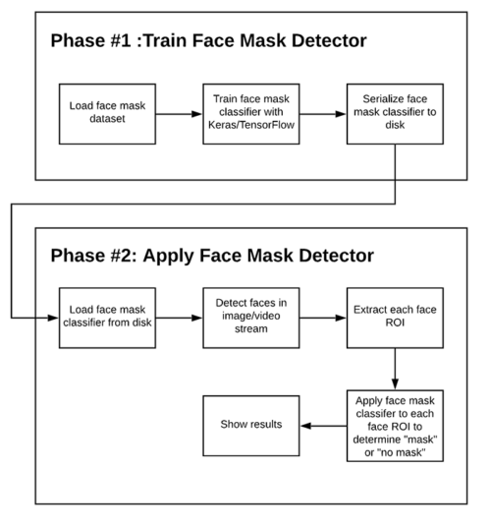
IMPLEMENTATION
TWO PHASE COVID-19 MASK
DETECTOR:
In order to train a custom face mask detector,
we need to break our project into two distinct phases,
each with its own respective sub-steps as shown
In figure.
Training
Testing

Slide 6

Training: Here we’ll focus on loading our face mask detection dataset from disk, training a model (using Keras/TensorFlow) on this dataset, and then serializing the face mask detector to disk
Deployment: Once the face mask detector is trained, we can then move on to loading the mask detector, performing face detection, and then classifying each face as with_mask or without_mask.
We will use these images to build a CNN model using TensorFlow to detect if you are wearing a face mask by using the webcam of your PC. Additionally, you can also use your phone’s camera to do the same!

Slide 7
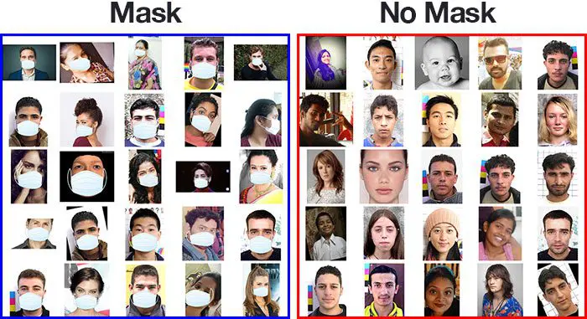
Stepwise Implementation
Step 1: Data Visualization
In the first step, let us visualize the total number of images in our dataset in both categories. We can see that there are 690 images in
the ‘yes’ class and 686 images in the ‘no’ class.
The number of images with facemask labelled ‘yes’: 690
The number of images with facemask labelled ‘no’: 686

Slide 8
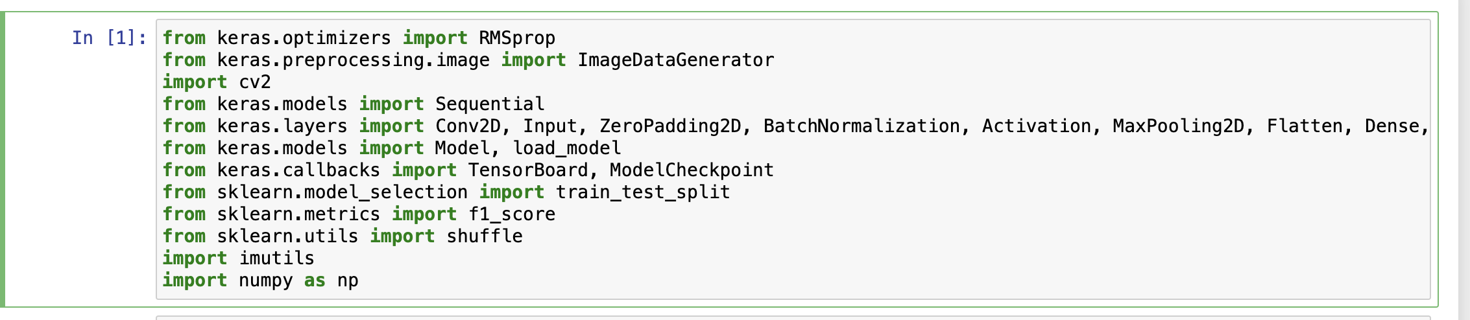
IMPORT NECESSARY PACKAGES

Slide 9
Step 2: Data Augmentation
In the next step, we augment our dataset to include more number of images for our training. In this step of data augmentation, we rotate and flip each of the images in our dataset. We see that, after data augmentation, we have a total of 2751 images with 1380 images in the ‘yes’ class and ‘1371’ images in the ‘no’ class.
Number of examples: 2751
Percentage of positive examples: 50.163576881134134%, number of pos examples: 1380
Percentage of negative examples: 49.836423118865866%, number of neg examples: 1371
Step 3: Splitting the data
In this step, we split our data into the training set which will contain the images on which the CNN model will be trained and the test set with the images on which our model will be tested. In this, we take split_size =0.8, which means that 80% of the total images will go to the training set and the remaining 20% of the images will go to the test set.
The number of images with facemask in the training set labelled ‘yes’: 1104 The number of images with facemask in the test set labelled ‘yes’: 276 The number of images without facemask in the training set labelled ‘no’: 1096 The number of images without facemask in the test set labelled ‘no’: 275

Slide 10
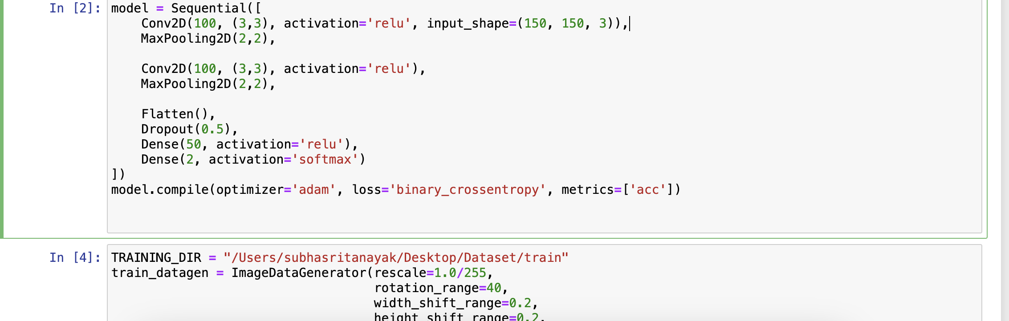
Step 4: Building the Model
In the next step, we build our Sequential CNN model with various layers such as Conv2D, MaxPooling2D, Flatten, Dropout and Dense. In the last Dense layer, we use the ‘softmax’ function to output a vector that gives the probability of each of the two classes.
Here, we use the ‘adam’ optimizer and ‘binary_crossentropy’ as our loss function as there are only two classes

Slide 11
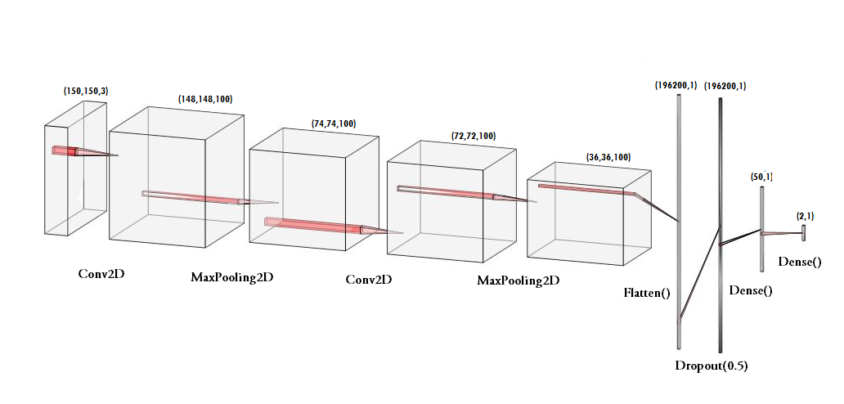
Overall view of CNNmodel

Slide 12
Step 5: Pre-Training the CNN model
After building our model, let us create the ‘train_generator’ and ‘validation_generator’ to fit them to our model in the next step. We see that there are a total of 2200 images in the training set and 551 images in the test set.
Found 2200 images belonging to 2 classes. Found 551 images belonging to 2 classes.
Step 6: Training the CNN model
This step is the main step where we fit our images in the training set and the test set to our Sequential model we built using keras library. I have trained the model for 10 epochs (iterations). However, we can train for more number of epochs to attain higher accuracy test there occurs over-fitting.
history = model.fit_generator(train_generator,
epochs=10,
validation_data=validation_generator,
callbacks=[checkpoint])
Epoch 10/10
132/132 [==============================] - ETA: 0s - loss: 0.1913 - acc: 0.9392INFO:tensorflow:Assets written to: model2-010.model/assets

Slide 13
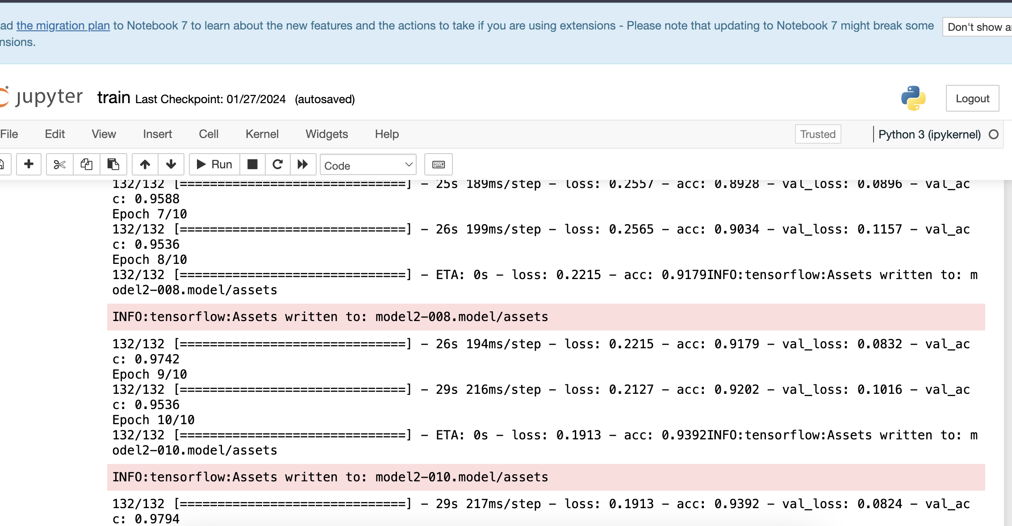
We see that after the 30th epoch, our model has an accuracy of 98.86% with the training set and an accuracy of 96.19% with the test set. This implies that it is well trained without any over-fitting.

Slide 14
Step 7: Labeling the Information
After building the model, we label two probabilities for our results. [‘0’ as ‘without_mask’ and ‘1’ as ‘with_mask’]. I am also setting the boundary rectangle color using the RGB values.[‘RED’ for ‘without_mask’ and ‘GREEN’ for ‘with_mask]
labels_dict={0:’without_mask’,1:’with_mask’} color_dict={0:(0,0,255),1:(0,255,0)}
Step 8: Importing the Face detection Program
After this, we intend to use it to detect if we are wearing a face mask using our PC’s webcam. For this, first, we need to implement face detection. In this, we are using the Haar Feature-based Cascade Classifiers to detect the facial features.
face_clsfr=cv2.CascadeClassifier(‘haarcascade_frontalface_default.xml’)
This cascade classifier is designed by OpenCV to detect the frontal face by training thousands of images. The .xml file for the same needs to be downloaded and used in detecting the face. We have uploaded the file to the GitHub repository.

Slide 15
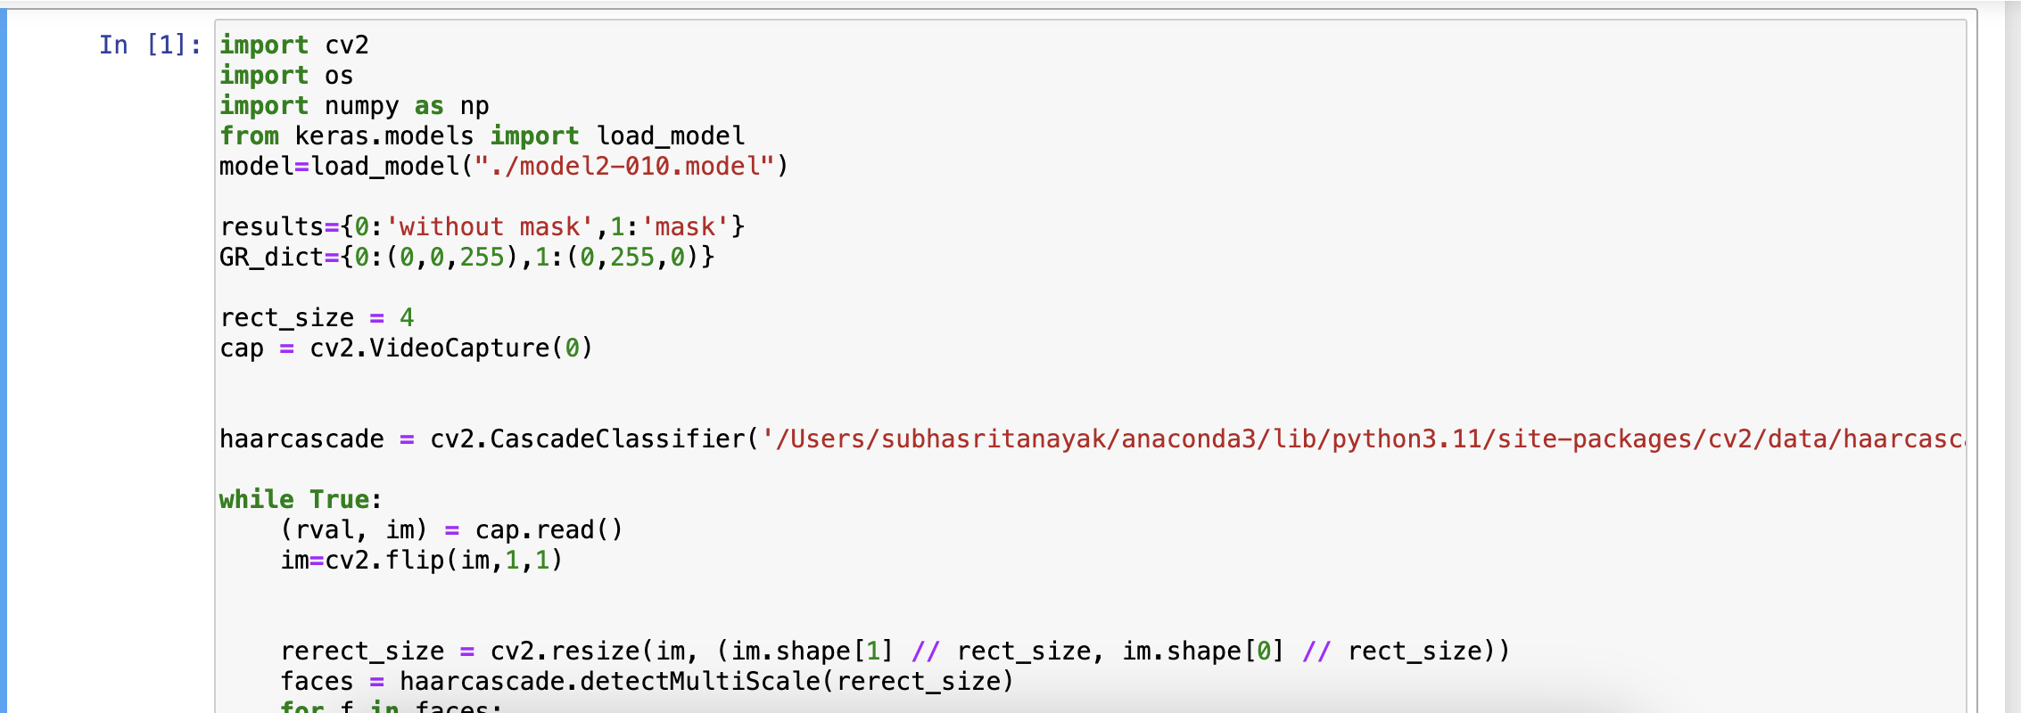
Step 9: Detecting the Faces with and without Masks
In the last step, we use the OpenCV library to run an infinite loop to use our web camera in which we detect the face using the Cascade Classifier. The code webcam = cv2.VideoCapture(0) denotes the usage of webcam.
The model will predict the possibility of each of the two classes ([without_mask, with_mask]). Based on the higher probability, the label will be chosen and displayed around our faces.

Slide 16
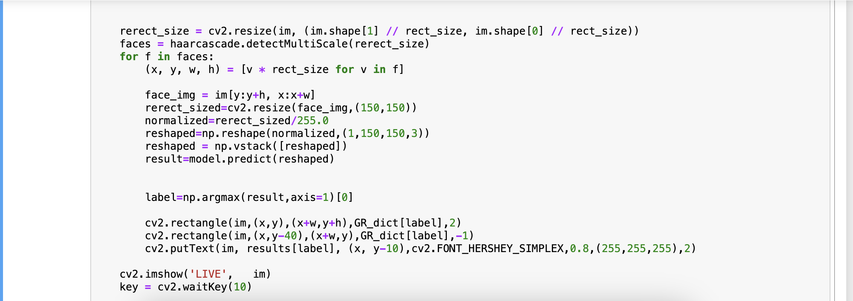


Slide 17
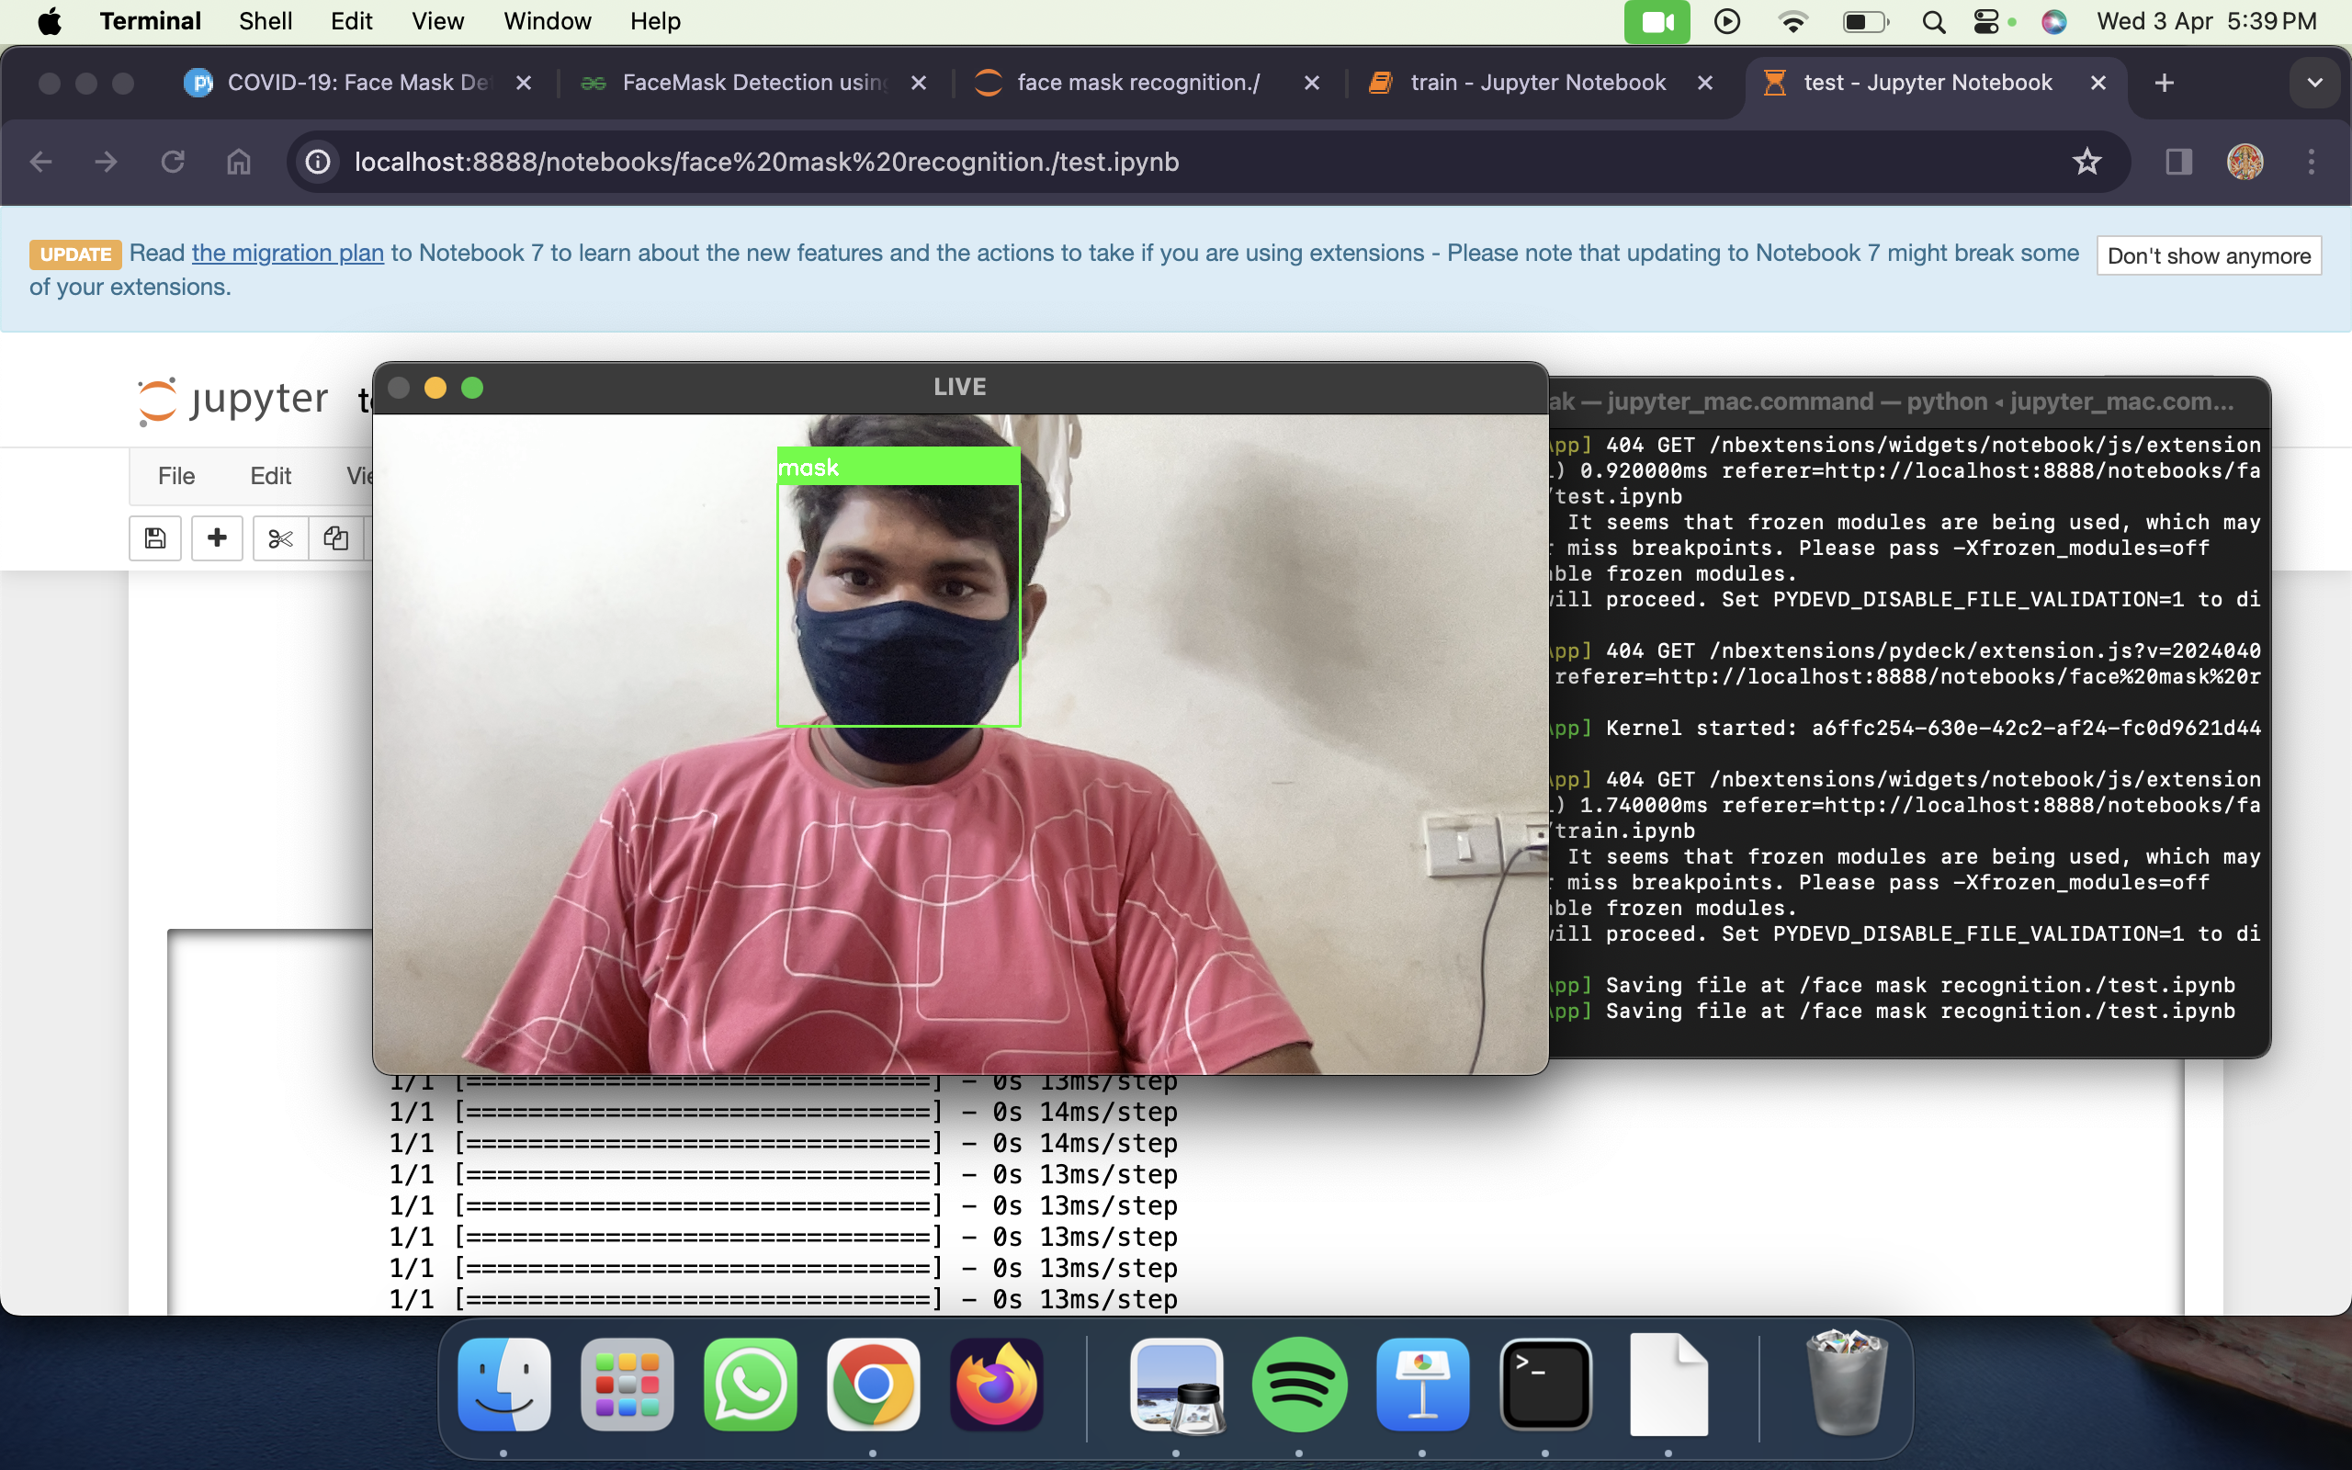
Results
With mask

Slide 18
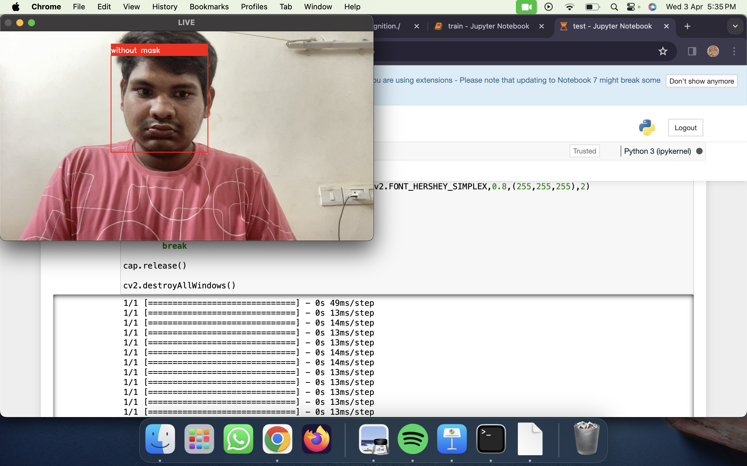
No Mask

Slide 19
CONCLUSION
In this Project, We had created a face mask detector using OpenCV, Keras/TensorFlow, and Deep Learning.
To create face mask detector, we trained a two-class model of people wearing masks and people not wearing masks.
We fine-tuned OUR model on our mask/no mask dataset and obtained a classifier that is ~93% accurate.
We then took this face mask classifier and applied it to both images by:
Detecting faces in images Extracting each individual face
Applying our face mask classifier
Our face mask detector is accurate, and since we used the MobileNetV2 architecture, it’s also computationally efficient,
making it easier to deploy the model to embedded systems (Raspberry Pi, Google Coral, Jetosn, Nano, etc.).
Corporate giants from various verticals are turning to AI and ML, leveraging technology at the service of humanity amid the pandemic. Digital product development companies are launching mask detection API services that enable developers to build a face mask detection system quickly to serve the community amid the crisis. The technology assures reliable and real-time face detection of users wearing masks. Besides, the system is easy to deploy into any existing system of a business while keeping the safety and privacy of users’ data. So the face mask detection system is going to be the leading digital solution for most industries, especially retail, healthcare, and corporate sectors. Discover how we can help you to serve the communities with the help of digital solutions.

Slide 20
REFERENCES
P. A. Rota, M. S. Oberste, S. S. Monroe, W. A. Nix, R. Campagnoli, J. P. Icenogle, S. Penaranda, B. Bankamp,K. Maher, M.-h. Chenet al., “Characterization of a novel coronavirus associated with severe acute respiratorysyndrome,”science, vol. 300, no. 5624, pp. 1394–1399, 2003.
Z. A. Memish, A. I. Zumla, R. F. Al-Hakeem, A. A. Al-Rabeeah, and G. M. Stephens, “Family cluster of middleeast respiratory syndrome
coronavirus infections,”New England Journal of Medicine, vol. 368, no. 26, pp.2487–2494, 2013.
Y. Liu, A. A. Gayle, A. Wilder-Smith, and J. Rocklöv, “The reproductive number of covid-19 is higher comparedto sars coronavirus,”Journal of travel medicine, 2020.
Y. Fang, Y. Nie, and M. Penny, “Transmission dynamics of the covid-19 outbreak and effectiveness of governmentinterventions: A data- driven analysis,”Journal of medical virology, vol. 92, no. 6, pp. 645–659, 2020.
N. H. Leung, D. K. Chu, E. Y. Shiu, K.-H. Chan, J. J. McDevitt, B. J. Hau, H.-L. Yen, Y. Li, D. KM, J. Ipet al.,“Respiratory virus shedding in exhaled breath and efficacy of face masks.”
S. Feng, C. Shen, N. Xia, W. Song, M. Fan, and B. J. Cowling, “Rational use of face masks in the covid-19pandemic,”The Lancet Respiratory Medicine, 2020.
Dataset Link :https://drive.google.com/folderview?id=1XDte2DL2Mf_hw4NsmGst7QtYoU7sMBVG

